Slide 1
Python vs. Java: A Comparative Analysis
Characteristics, Use Cases, and Advantages
Yusuf Babatunde
1st September 2024

Slide 2
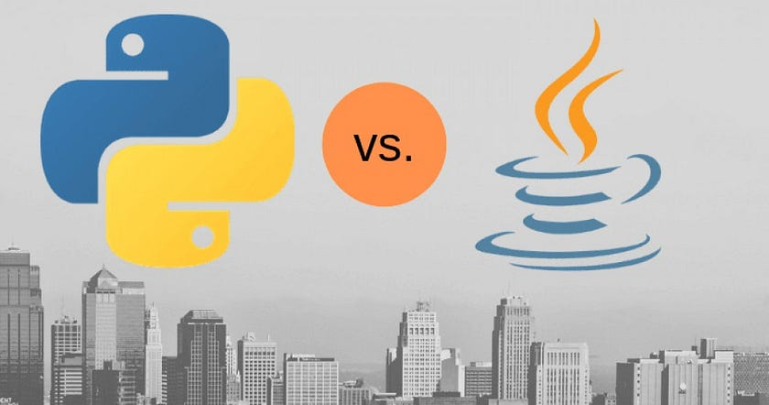
Introduction
Python is widely used in data science due to its extensive libraries and frameworks, such as NumPy, Pandas, and Scikit-learn. It offers a rich data manipulation, analysis, and machine learning ecosystem. Java also has libraries and frameworks for data science but is not as commonly used as Python.

Slide 3
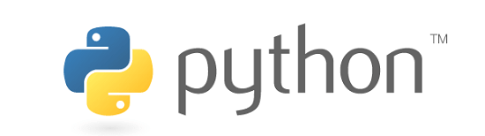
PYTHON
Released and created by Guido van Rossum in the year 1991, Python is a dynamic, high-level, open-source programming language that supports both object-oriented programming and procedural-oriented programming. Python was designed with the aim to make it easier to read codes as compared to other languages.
Since Python syntax is nothing different from the English language or human speech, Python has managed to do exactly that. It is easy to read, easy to understand, and consequently, easy to learn.

Slide 4
Features of Python
It is the features provided by Python that make it so popular in today’s day and age. A few of them are mentioned below.
There is no use of curly brackets or semicolons, making it easy to use and learn for beginners.
It supports object-oriented programming. This form of programming entirely depends on ‘objects’ as a concept, which means that data structures have their own attributes or properties and procedures or methods. These objects interact with each other and help make programming faster and cleaner, and make codes easy to debug, and easy to reuse.
It supports GUI programming to develop Desktop applications.
Integrating Python with other programming languages such as Java, C++, or C is easy.
It can run cross-platform including UNIX, Macintosh, Windows, Linux, and more. Hence, it is a portable programming language.
Since Python is easy to debug, maintaining its source code is not as challenging.
It conducts automated garbage collection internally, making programming simpler. This means that the objects that are not being used by the application will be removed automatically.

Slide 5
Applications of Python
Python can be used for:
Machine learning
Artificial intelligence
Programming
Web development
Data analytics
Game development
Data visualization

Slide 6
USES CASES FOR PYTHON
It is one of the relatively new use cases in Python that uses Python to handle Data Science projects such as NumPy, Pandas, etc. Do you want a career in Data Science? Learn Python language for the same. It offers feature-rich data visualizations.
One of the best Python use case examples for Data Science is NASA. It used the PyMars library for analyzing data from Mars Rover Mission.

Slide 7
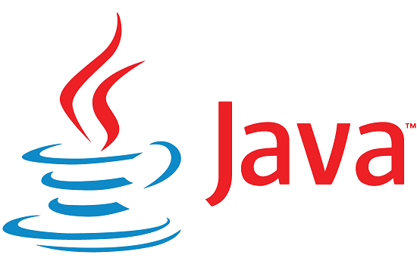
JAVA
Java is a compiled, general-purpose programming language that is commonly used for Java app development. Just like Python, Java supports object-oriented programming.
This programming language was created by James Gosling in the year 1955 and was designed to transform the user’s experience of the web. It was Java that led to the transformation of text-based web pages to now pages with animation and videos.
Java also has its share of libraries that developers can use to find code for a certain purpose

Slide 8
Features of Java
The list of features that have kept Java at the top all these years includes:
For those who have knowledge of C++, learning Java is not challenging. Its syntax is clean and easy to learn.
Just like Python, Java also supports object-oriented programming.
It is a WORA language, which means write once, run anywhere. It is not limited to specific platforms. The codes can be used across platforms including Linux, Mac/OS, Windows, and more.
It provides automatic removal of objects that aren’t being used by the application any longer.
Java provides securities, such as categorizing local file systems separately from the ones imported from network sources, checking for illegal codes, or narrowing down resources that can be accessed by a class, by default. This makes it one of the safest languages to develop systems that are virus-free.
It is multi-threaded and thus, programmers can write codes that can handle multiple tasks at once.
Java has been specifically designed for the distributed environment of the web. This means the user can access files from any machine on the net.

Slide 9
Applications of Java
Java can be used for:
IoT applications
Desktop GUI programming
Game development
Mobile app development
Cloud-based application development
Big Data technologies
Scientific applications

Slide 10
USES CASES OF JAVA
Scientific Application
Scientific app development is one of the most common use cases for Java-based development. With the help of Java's ability to handle huge amounts of data, scientists can efficiently perform long and complicated computational tasks. Besides, Java has a wide selection of libraries, like Apache Commons Math, JAMA, and JOONE, that provide apps with the ability to gather statistics, manage algebra operations, and benefit from machine learning.
Some of the popular scientific Java applications examples are as follows:
Orca
MitoMonkey
MATLAB (Mathematics Laboratory)
Octave
Weka (for Machine Learning)

